Slide 1
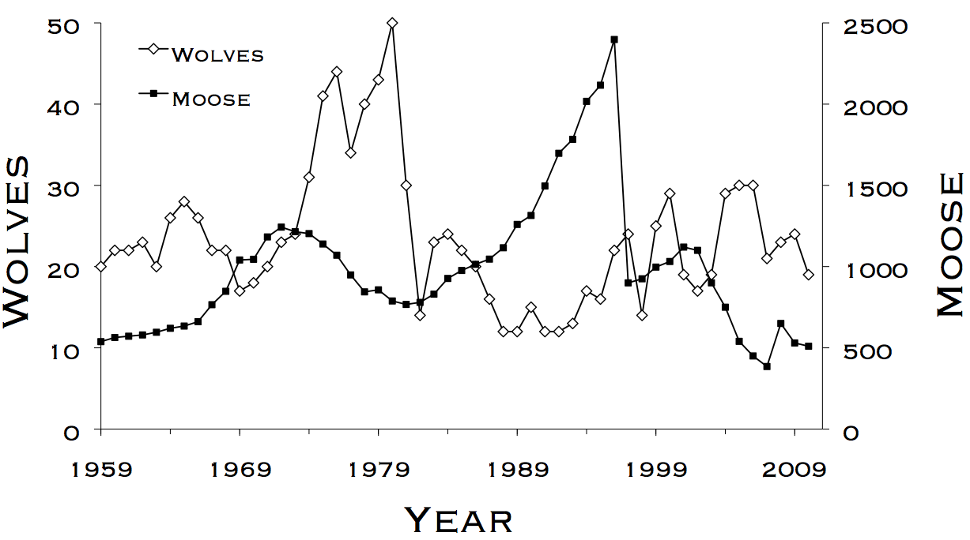
Lab 5 – Cormack-Jolly Seber Models
WLE 411, Week 9

Slide 2
Survival- a special case of Bernoulli trial
Flip a coin. If it’s heads, keep flipping until it’s tails or you reach 5 flips
Write down the results as “1” for heads, and “0” for tails
The results should look like this:
Survived 0 coin flips: 00000
Survived 3 coin flips: 11100

Slide 3
Survival- a special case of Bernoulli trial
What’s the probability of the coin “surviving” from one interval to the next?
0.5
We’re going to call this parameter Φ, pronounced phi or fee
In wildlife populations, this parameter represents apparent survival
Probability that an animal survives & doesn’t emigrate until the next interval

Slide 4
Capture histories
Capture histories are used to determine when an animal died/emigrated
Rows indicate individuals, columns indicate capture intervals (days, weeks, etc.)
Week 1 | Week 2 | Week 3 | Week 4 | Week 5
1 | 1 | 0 | 0 | 0
1 | 1 | 1 | 1 | 1
1 | 0 | 0 | 0 | 0

Slide 5
Capture histories
In the coin example, we had perfect knowledge of whether each coin “lived” or “died”
In the real world, we’re often uncertain regarding an animal’s current state
Week 1 | Week 2 | Week 3 | Week 4 | Week 5
1 | 1 | 0 | 0 | 0
1 | 1 | 1 | 1 | 1
1 | 0 | 0 | 0 | 0

Slide 6
New parameter: p
p represents recapture/detection probability
The probability of recapturing an animal in a mark recapture study is defined as:
The probability of the animal surviving from the prior interval (Φ) * the probability of reobserving the animal (p)

Slide 7
Revised capture histories
Once we’ve incorporated p into our models, we can have gaps in our capture histories
Gaps represent animals surviving undetected to be resighted in late weeks
Week 1 | Week 2 | Week 3 | Week 4 | Week 5
1 | 0 | 1 | 0 | 0
1 | 1 | 0 | 0 | 1
1 | 0 | 0 | 0 | 0

Slide 8
Capture history likelihoods
Much like binomial likelihoods, we can calculate how likely a given capture history is given certain values of Φ and p
Example:
The likelihood of observing the capture history 111 can be expressed as:
Φ₁*p₂*Φ₂*p₃
The likelihood of observing 101 can be expressed as:
Φ₁ * (1 - p₂) * Φ₂ * p₃
The probability of being observed in interval 3
The probability of surviving from interval 1 to interval 2
The probability of not being observed in interval 2
The probability of surviving from interval 2 to 3
Notes:
This can get complicated fast, especially with longer capture histories. Hence, we generate likelihoods using programs like MARK

Slide 9
Cormack-Jolly Seber (CJS) model
The model we’ve been describing is called a CJS model
Basic survival model with two parameters, Φ and p
Data collected using a mark-recapture framework
We can calculate Φ and p parameters separately for different sexes, time periods, etc.
We can then compare different model structures using AIC, as demonstrated last week

Slide 10
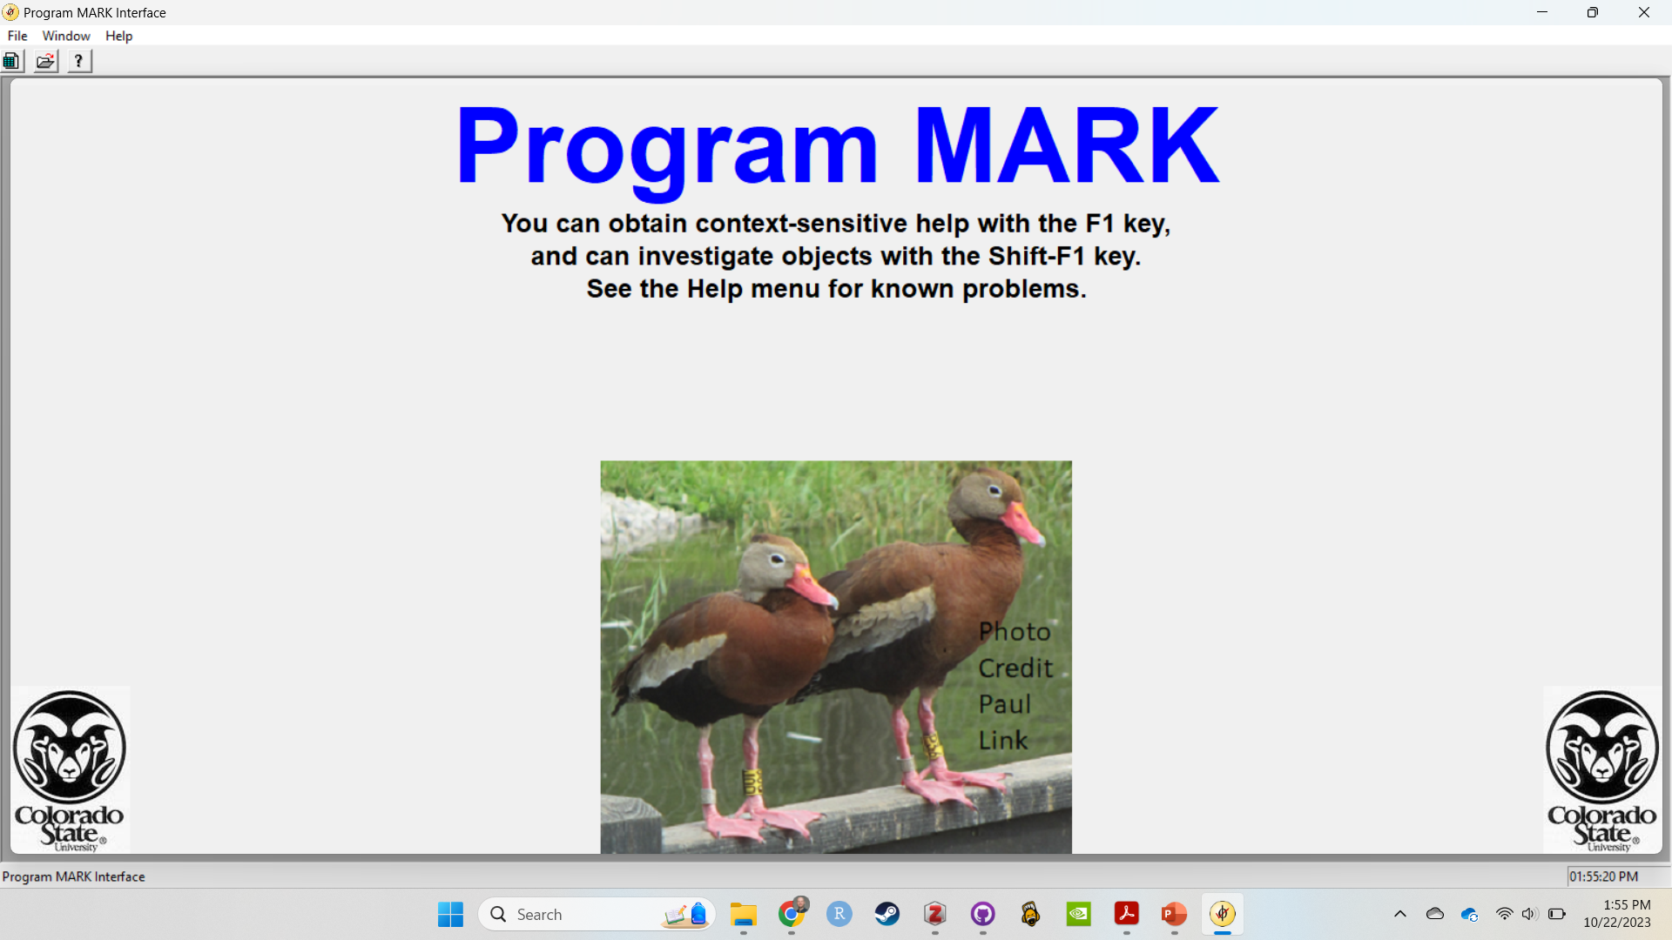
Notes:
Today we’ll be using Program Mark (accessed through R using the RMark package) to solve CJS models

